Slide 1
Human motion prediction from Monocular Video

Slide 2
Goal
Vision : Train computers to “see” us
Understand our behaviors, emotion, actions
Understand our interactions with each other and the world
AR/VR/Graphics: Train avatars to mimic us
By watching us, learn to behave like us
If we can reproduce human-like behavior, then we have understood it at some level

Slide 3
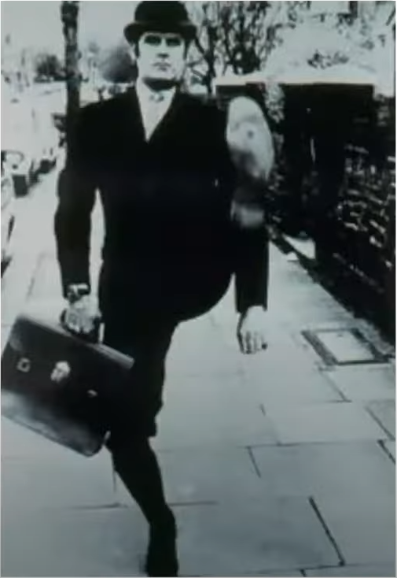
Challenge
Loss of 3D in 2D projection
Unusual poses
Self occlusion
Low contrast

Slide 4
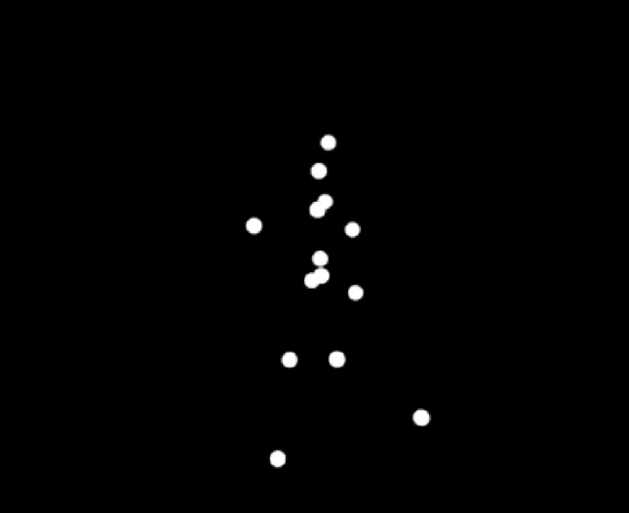
A key influence on the field
“… the motion of the living body was represented by a few bright spots describing the motions of the main joints… evoke a compelling impression of human walking, running, dancing, etc. “
Gunnar Johansson

Slide 5
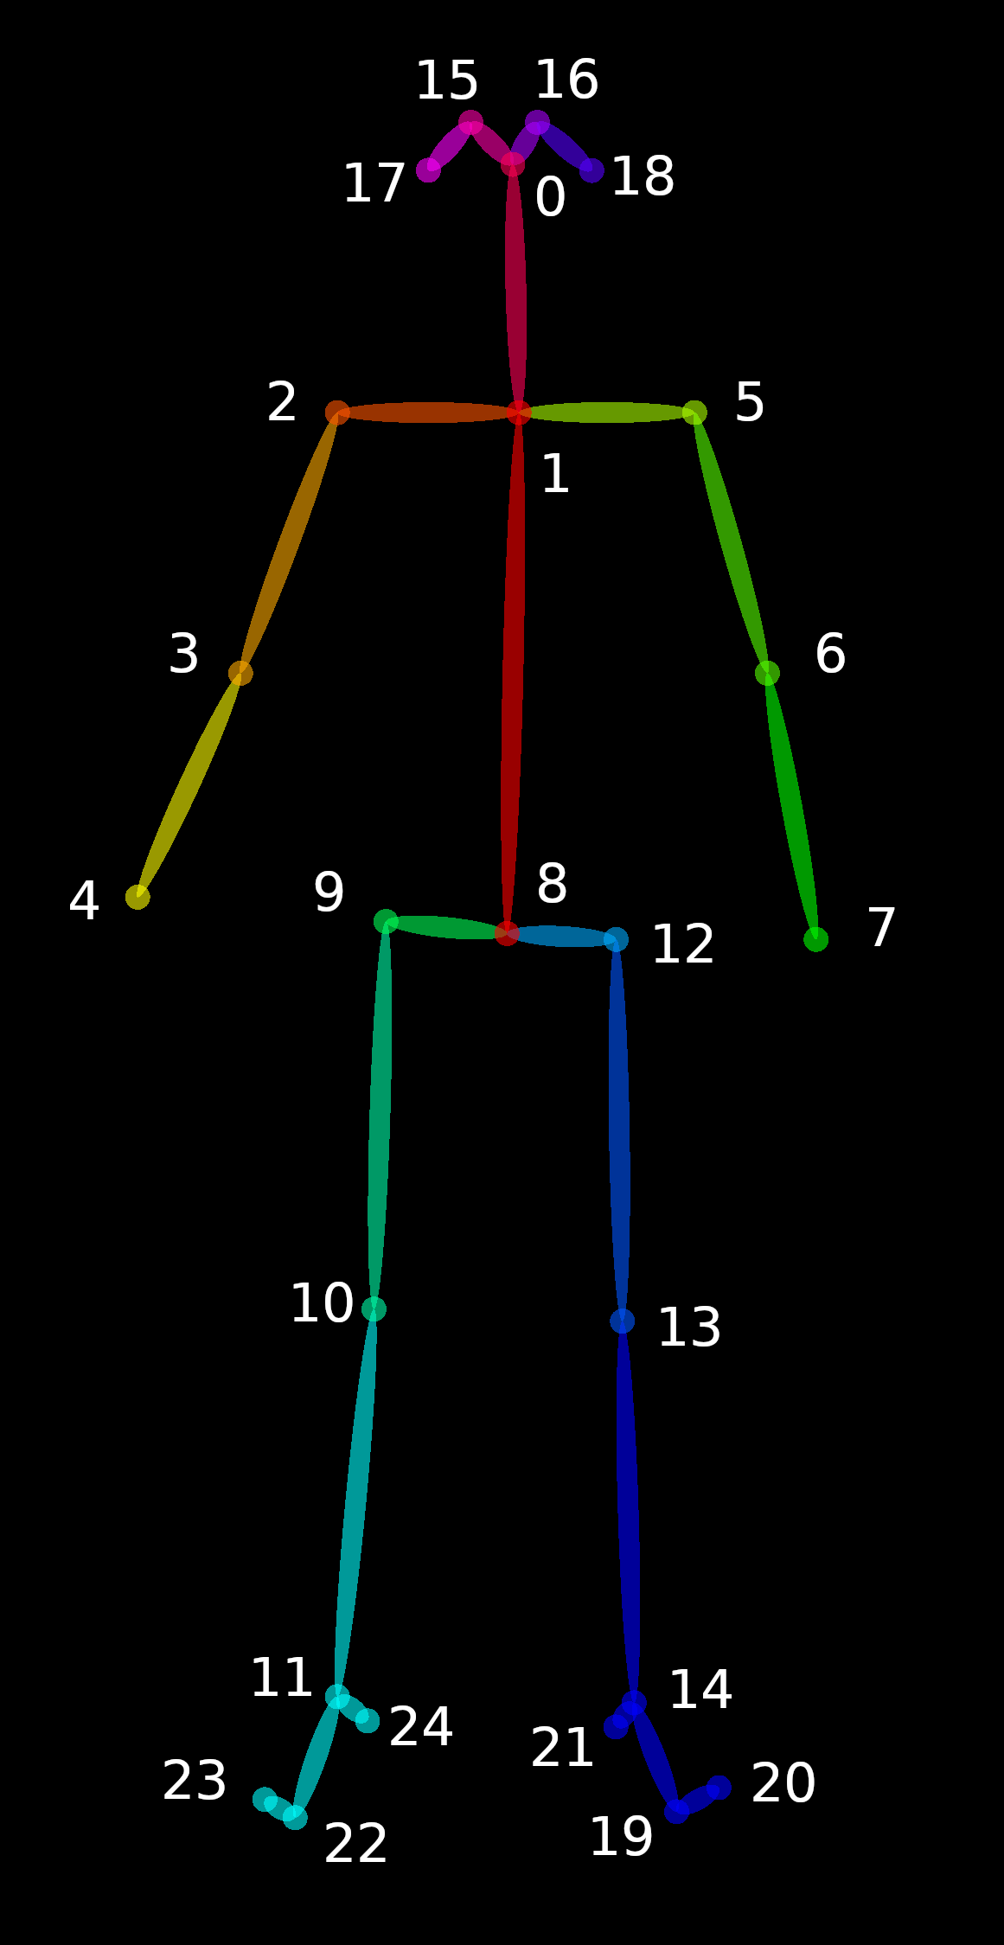
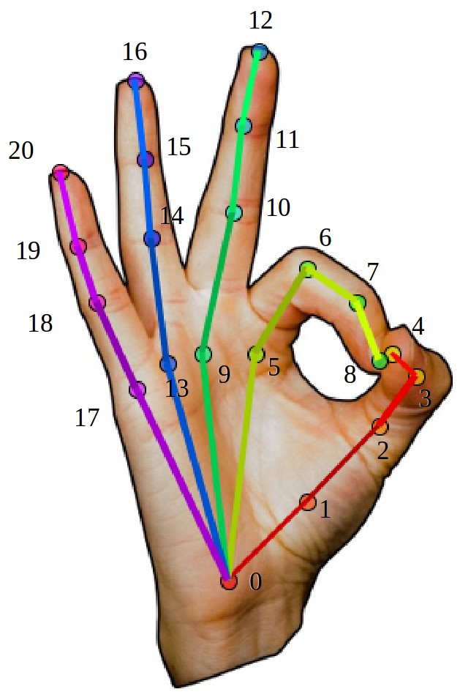
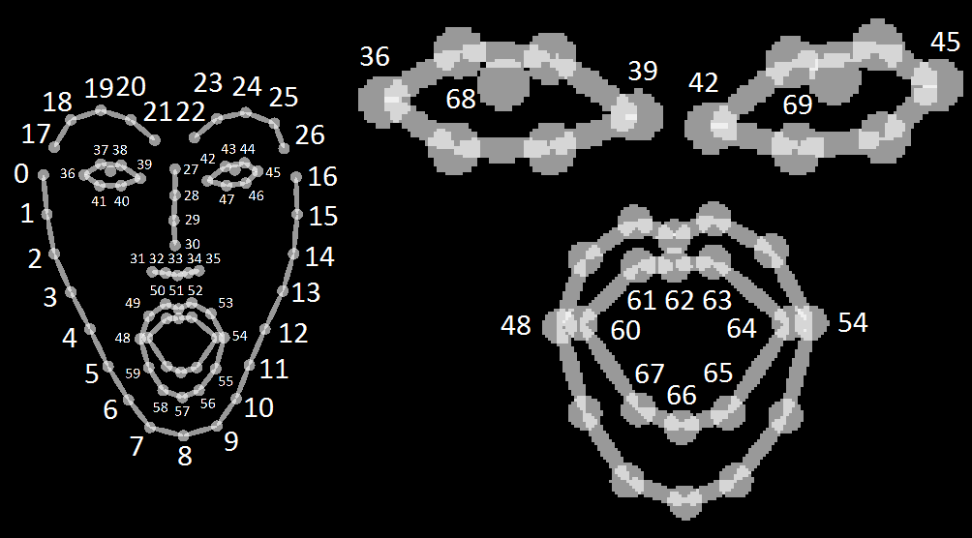
Dominant paradigm: 2D joints
OpenPose, Cao et al., 2017, 2018

Slide 6
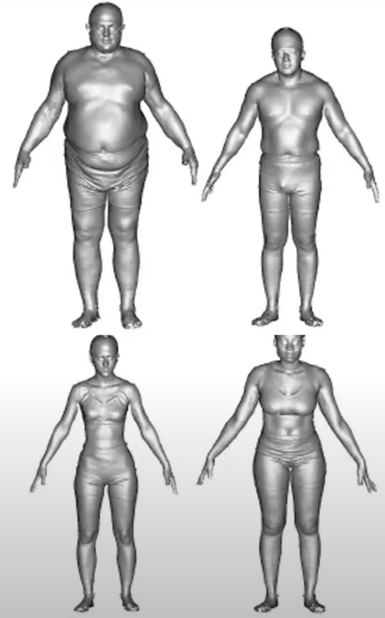
Are joints enough?
The joints are unobserved.
Contact is key. Joints don’t touch the world; the skin does.
We need to model the surface of the body to reason about contact and expression.
Our shape is also related to our health and how the world perceives us.

Slide 7
Challenge
The body has about
600 muscles,
200 bones,
200 joints, and many types of joints.
We also bulge, breath, flex, and jiggle.
Our shape changes with our age, our fitness level, and what we had for lunch.

Slide 8
Contact
Contact detection is important for various fields, including:
Robotics (for collaborative robots)
Health and safety (detecting falls, accidents)
Entertainment and gaming (gesture and interaction analysis)

Slide 9
Human motion prediction
Methods:
Traditional methods of detecting human contact often rely on multi-camera setups, depth sensors, or markers.
Using only a single camera (monocular video)

Slide 10
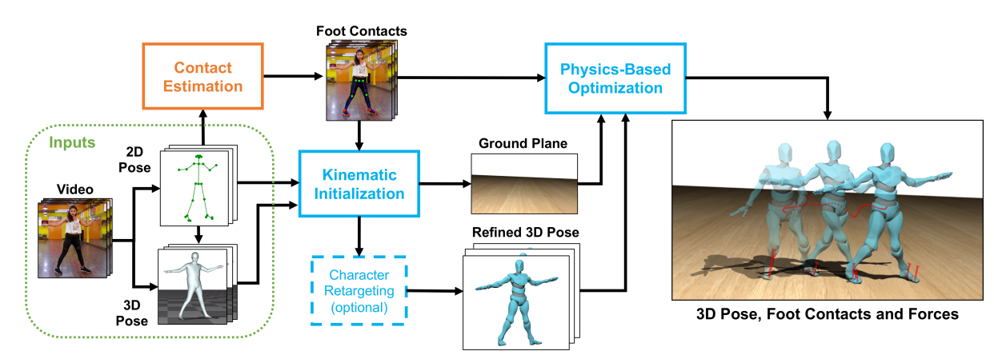
Methodology
Stage 1: Kinematic Pose Estimation
Stage 2: Foot contact and Motion State Prediction
Stage 3: Physics-Based Optimization
Human Dynamics, Davis Rempe et al., 2020

Slide 11
Kinematic Pose Estimation
In the context of human motion, it involves determining the positions and
orientations of the body’s joints and limbs as they move over time.
Method:
Step 1: predict 2D and 3D joint positions
Step 2: using IK to compute joint angles
The result of stage 1 is a temporally-consistent joint angle sequence, but captured poses can exhibit artefacts and contradict physical plausibility:
evince floor penetration
incorrect body leaning
temporal jitter

Slide 12
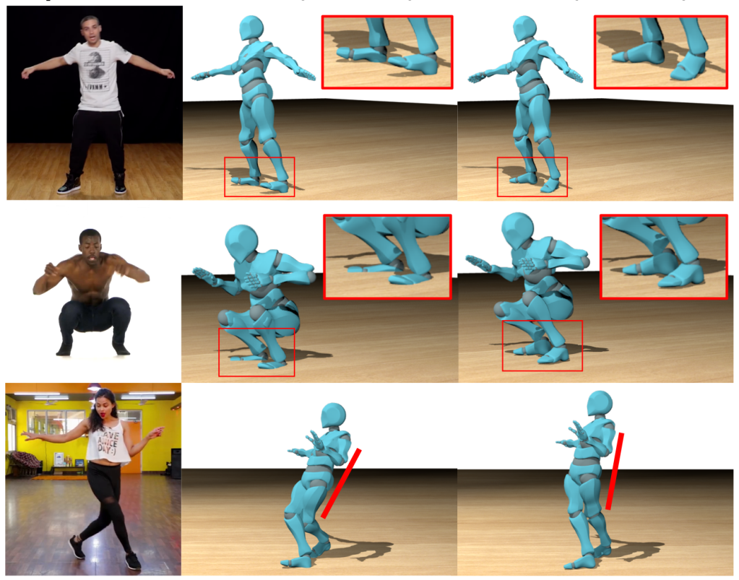
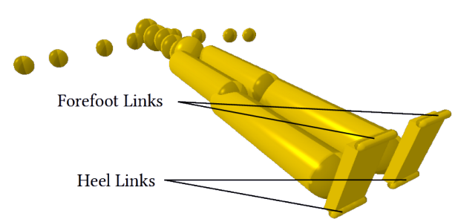
Foot contact
We need to infer when the subject’s feet are in contact with the ground, given a video frame
Classifies whether the toe and heel of each foot are in contact with the ground

Slide 13
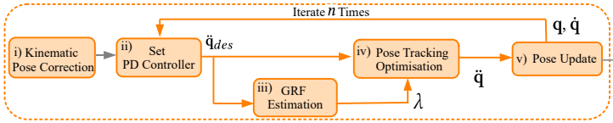
Physics-Based Optimization
There are two common types of controllers in existing RL-bases animation
algorithms: the proportional-derivative (PD) controller and torque-based controller.

